Slide 1
Digital Image Processing
Image Restoration
Noise models and additive noise removal
SCUI, Lahore Campus -- CSC 331: Digital Image Processing -- © Dr. Usama Ijaz Bajwa

Slide 2
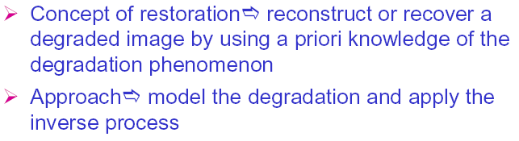
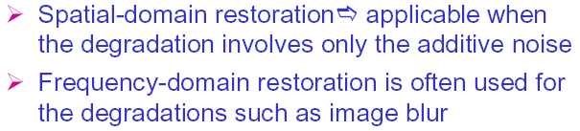
Image Restoration
CUI, Lahore Campus -- CSC 331: Digital Image Processing -- © Dr. Usama Ijaz Bajwa

Slide 3
Image Restoration
What is noise (in the context of image processing) and how can it be modeled?
What are the main types of noise that may affect an image?
What are the possible solutions?
Subjective Vs Objective (Enhancement Vs Restoration)
CUI, Lahore Campus -- CSC 331: Digital Image Processing -- © Dr. Usama Ijaz Bajwa

Slide 4
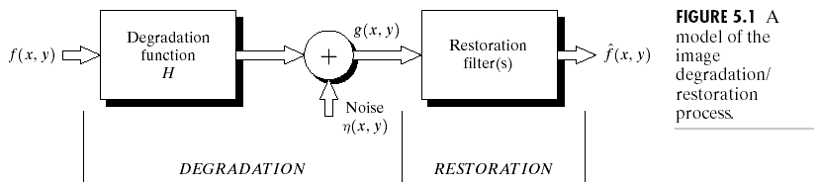
Degradation Model for a Digital Image
CUI, Lahore Campus -- CSC 331: Digital Image Processing -- © Dr. Usama Ijaz Bajwa

Slide 5
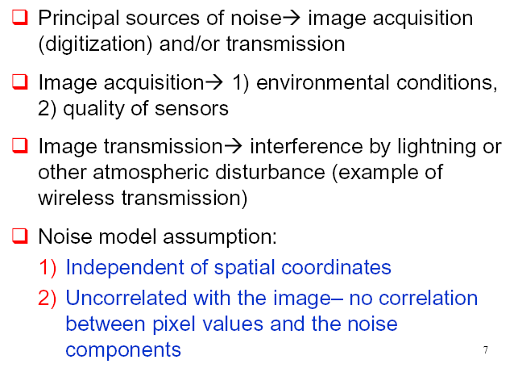
Noise Models
CUI, Lahore Campus -- CSC 331: Digital Image Processing -- © Dr. Usama Ijaz Bajwa

Slide 6
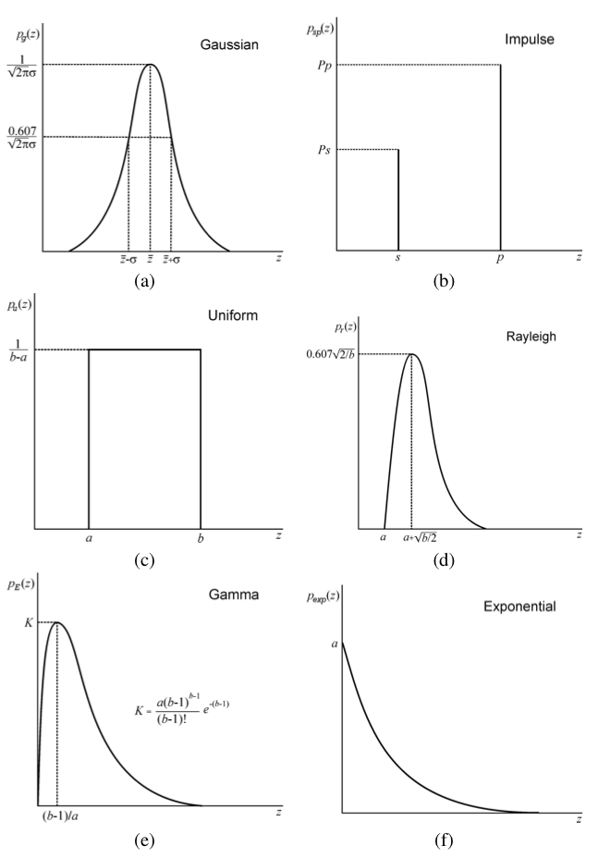
Noise and Noise Models
Gaussian (normal)
Impulse (salt-and-pepper)
Uniform
Rayleigh
Gamma (Erlang)
Exponential
CUI, Lahore Campus -- CSC 331: Digital Image Processing -- © Dr. Usama Ijaz Bajwa

Slide 7
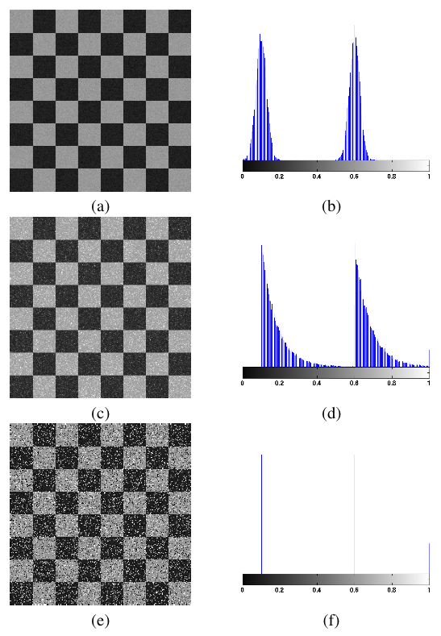
Effect of Noise on Images & Histograms
Gaussian
Exponential
Impulse
(salt-and-pepper)
CUI, Lahore Campus -- CSC 331: Digital Image Processing -- © Dr. Usama Ijaz Bajwa

Slide 8
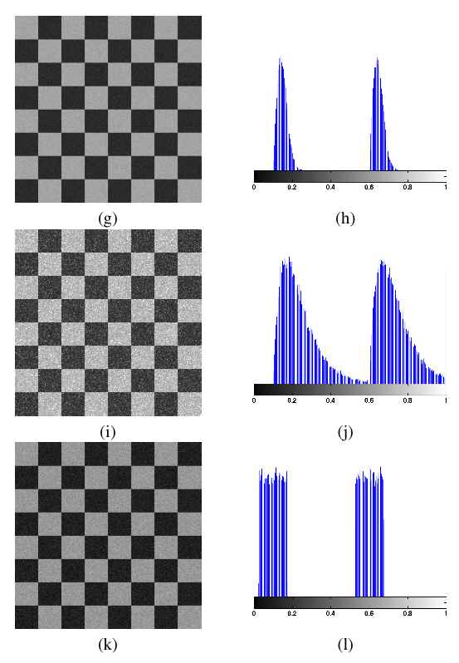
Effect of Noise on Images & Histograms
Rayleigh
Gamma (Erlang)
Uniform
CUI, Lahore Campus -- CSC 331: Digital Image Processing -- © Dr. Usama Ijaz Bajwa

Slide 9
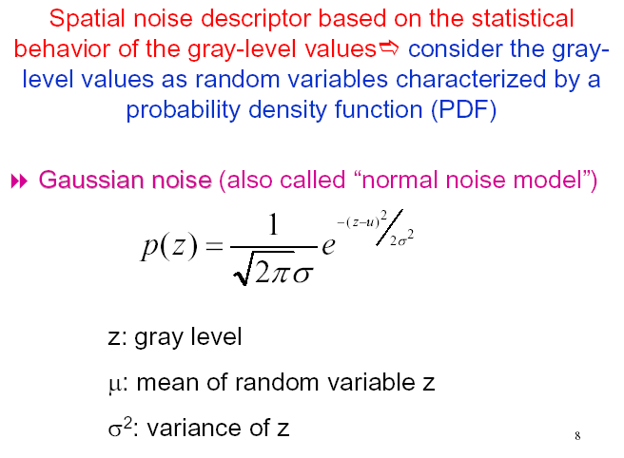
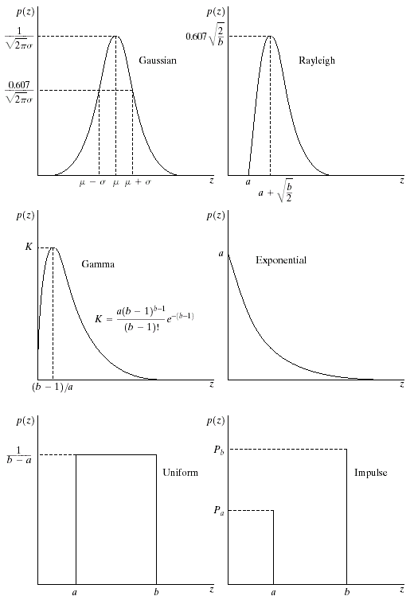
Noise Models: Gaussian Noise
CUI, Lahore Campus -- CSC 331: Digital Image Processing -- © Dr. Usama Ijaz Bajwa

Slide 10
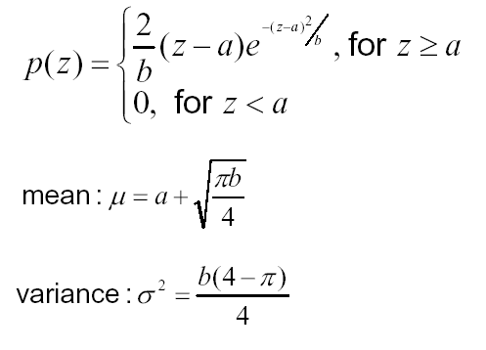

Noise Models: Rayleigh Noise
CUI, Lahore Campus -- CSC 331: Digital Image Processing -- © Dr. Usama Ijaz Bajwa

Slide 11
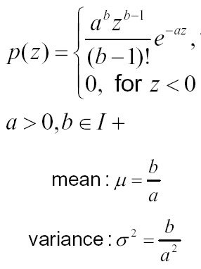

Noise Models: Erlang (Gamma) Noise
CUI, Lahore Campus -- CSC 331: Digital Image Processing -- © Dr. Usama Ijaz Bajwa

Slide 12

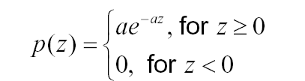

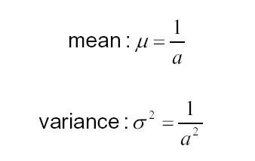
Noise Models: Exponential Noise
Where
CUI, Lahore Campus -- CSC 331: Digital Image Processing -- © Dr. Usama Ijaz Bajwa

Slide 13
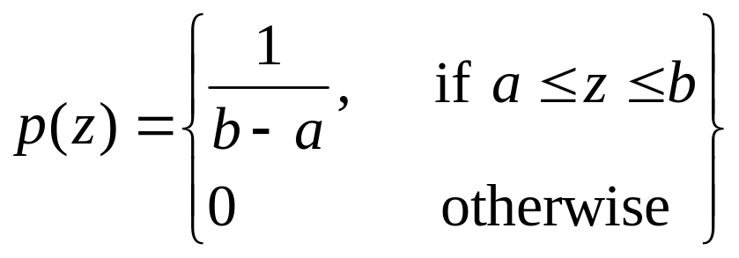
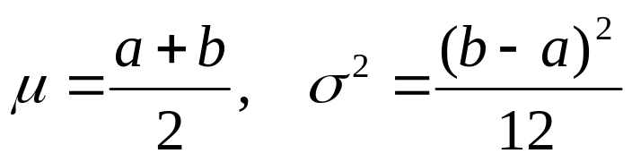
Noise Models: Uniform Noise
The mean and variance are
given by
CUI, Lahore Campus -- CSC 331: Digital Image Processing -- © Dr. Usama Ijaz Bajwa

Slide 14
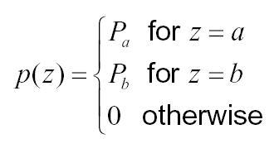
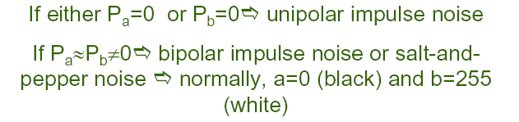
Noise Models: Impulse (Salt and Pepper) Noise
CUI, Lahore Campus -- CSC 331: Digital Image Processing -- © Dr. Usama Ijaz Bajwa

Slide 15


Effect of Noise on Images & Histograms
CUI, Lahore Campus -- CSC 331: Digital Image Processing -- © Dr. Usama Ijaz Bajwa

Slide 16
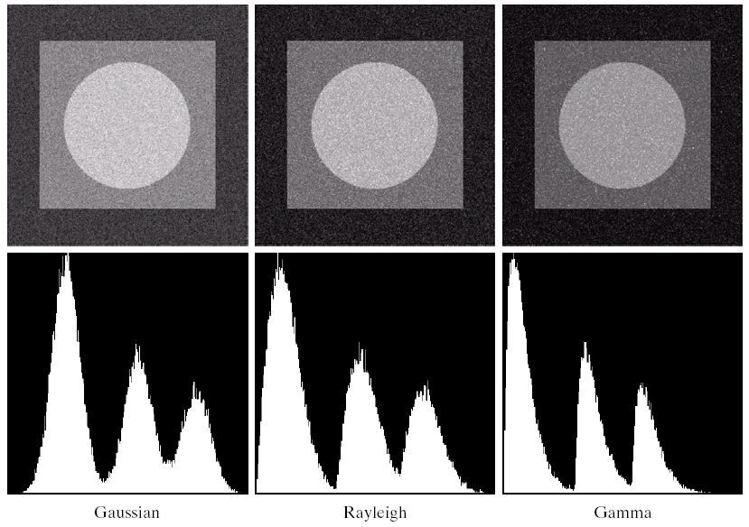
Effect of Noise on Images & Histograms
CUI, Lahore Campus -- CSC 331: Digital Image Processing -- © Dr. Usama Ijaz Bajwa

Slide 17
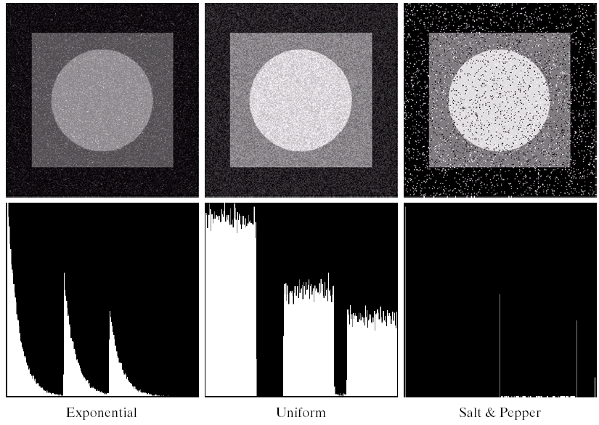
Effect of Noise on Images & Histograms
CUI, Lahore Campus -- CSC 331: Digital Image Processing -- © Dr. Usama Ijaz Bajwa

Slide 18
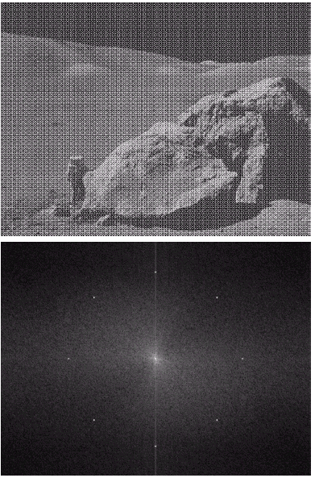
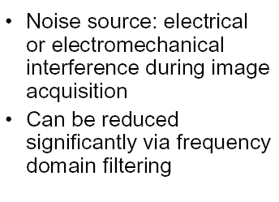
Periodic Noise (Example)
Spatially Dependent Case
CUI, Lahore Campus -- CSC 331: Digital Image Processing -- © Dr. Usama Ijaz Bajwa

Slide 19
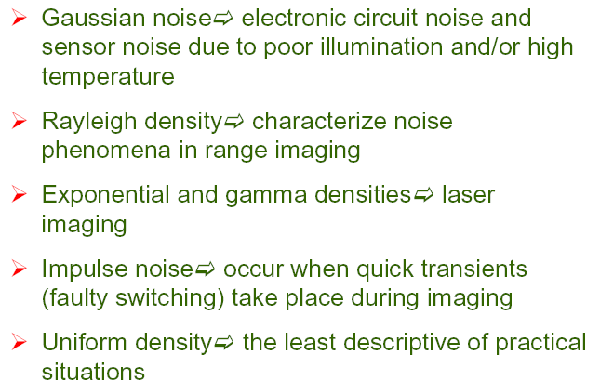
Applicability of various noise models
CUI, Lahore Campus -- CSC 331: Digital Image Processing -- © Dr. Usama Ijaz Bajwa

